Slide 1
Electricity Bill Management System
Group 16
8/18/2021

Slide 2
Objectives
Real-Time Monitoring: Track Electricity bills and complaints of the customer in real time.
Customer Interface: New customers and existing customers can easily access their accounts.
Tracking: Customers as well as administrators can track previous bill records.
complaint registration: Customers can register complaints about power outages, fluctuations and breakdowns.
Bill Payment: Customers can easily pay their bills without the hassle of visiting the office physically.
ease of complaint resolution: Company can easily track complaints and resolve them.
notifications: Company can notify customers about the status of their complaints and let them know if a complaint is resolved

Slide 3
Task Allocation
Radhika Tamboli | Customer Registration | User Login
Harsh Sharma | Register Complaint | Search Complaint
Aniket Phand | View Bills | Pay Bills
Sushant Joshi | Soft Delete Customer Account | Restore Customer Account
Shrihari Samag | Administrator Registration | Customer Details Update
Rekha Maddin | View Bill history | Complaint history

Slide 4
Sprint Goals
Implement customer and administrator registration
Develop user login functionality
Establish database structure for storing user data
Establish database structure for storing user data
implement view bill functionality
Integrate payment gateway for bill payments
Implement register complaint features
Develop search complaint and complaint history functionality
Implement soft delete and restore customer account features
Conduct thorough testing of all implemented features
Address any bugs or issues

Slide 5
Sprint Retrospective
What went well
Successful implementation of core features
Effective Collaboration between team members
Understanding advanced concept of java
learned to manage delivery within time
2. What could be improved
Some challenges encountered while integrating
minor bugs while testing
letter understanding of documentation

Slide 6
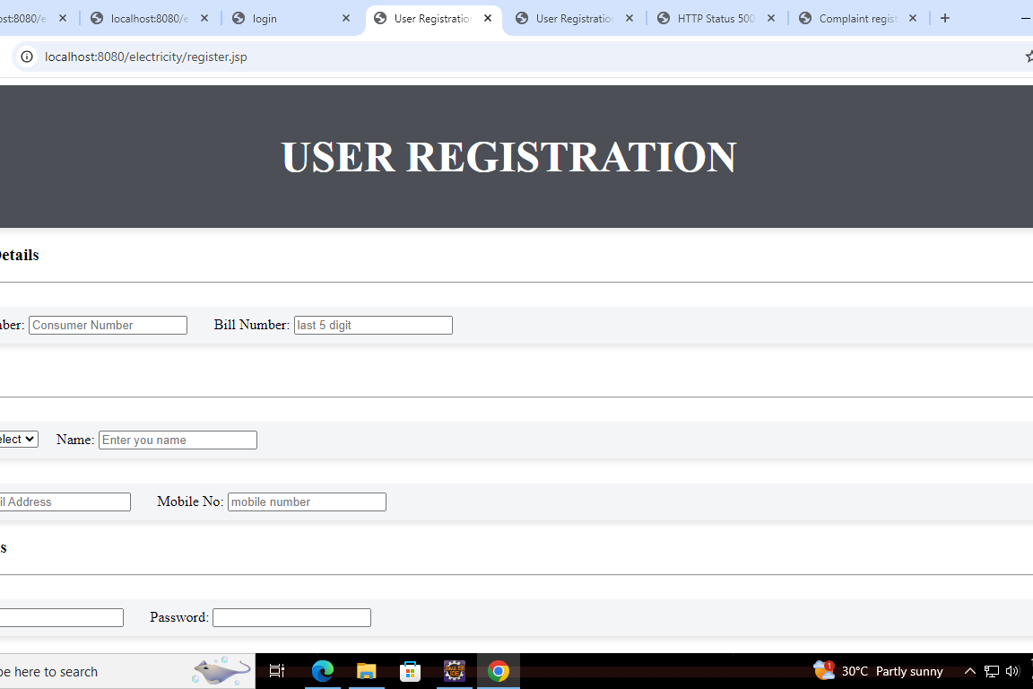
Funtionalities
New User Registration :
New user can register themselves.

Slide 7
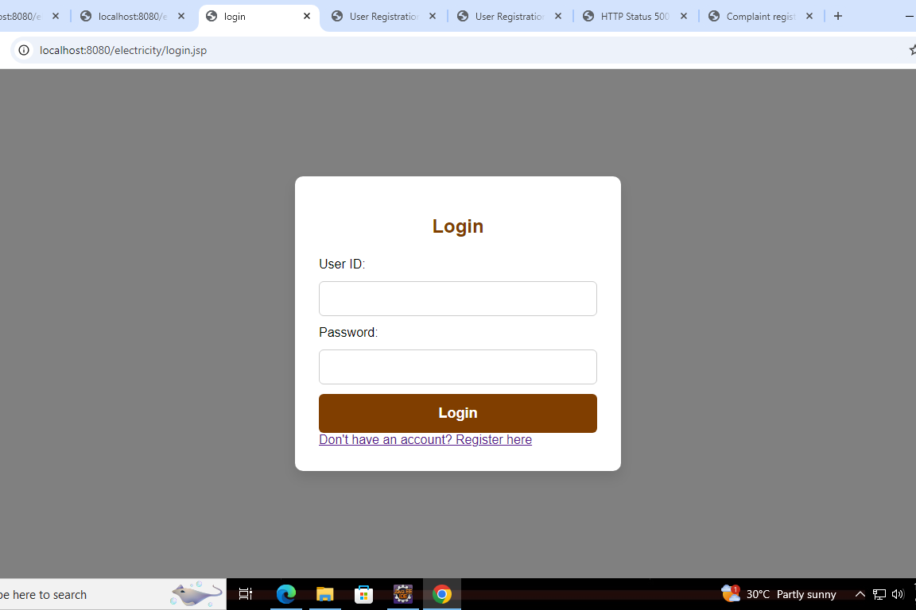
Existing user login:
Existing users can login into their account

Slide 8
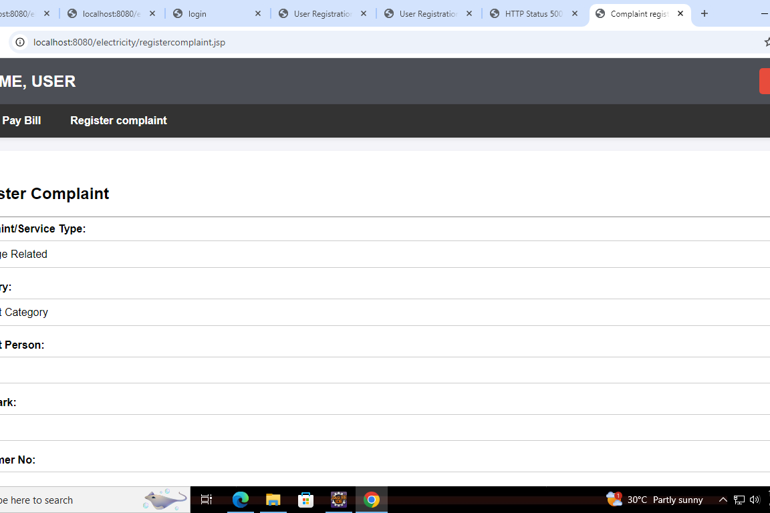
Complaint Registration:
Customers can register complaints regarding their issues like power outage, Fluctuations.

Slide 9
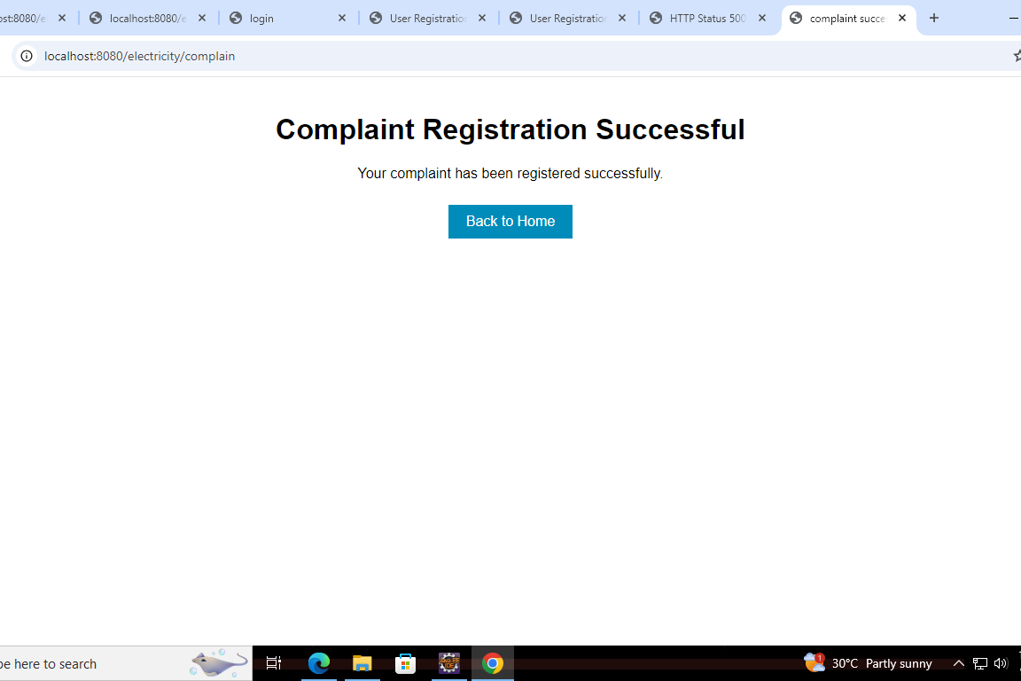
Complaint acknowledgement:
users get acknowledgement of the complaints they registered

Slide 10
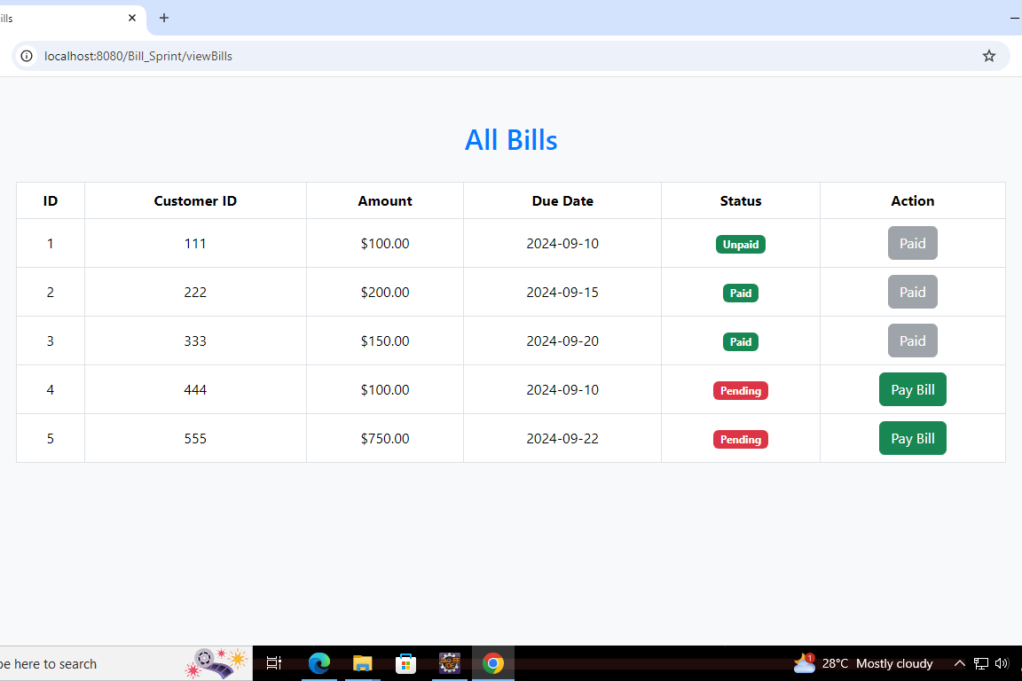
Bills:
Customers can view all pending and paid bills.

Slide 11
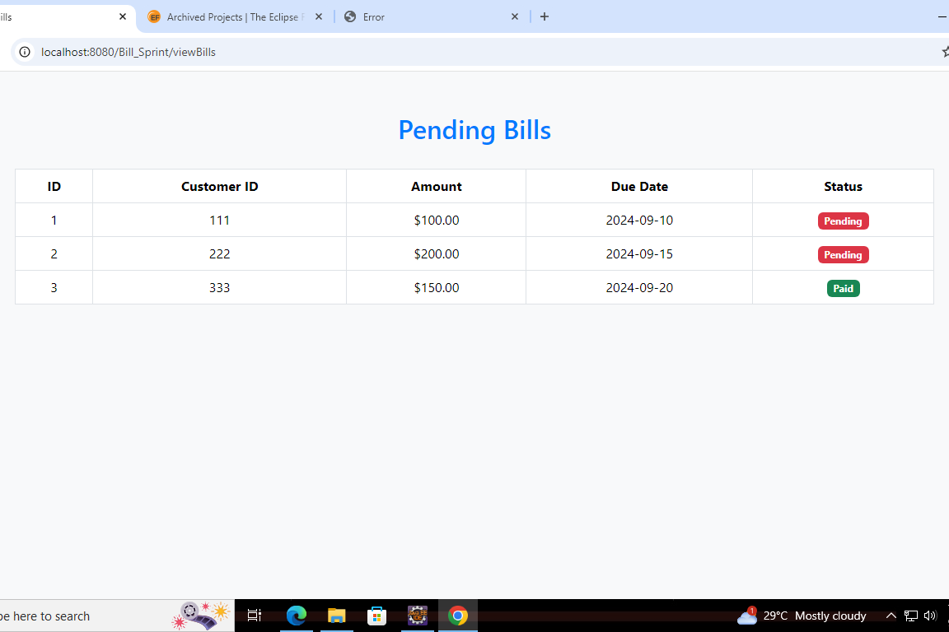
Pay Bills:
Customers can view pending bills and pay them.

Slide 12
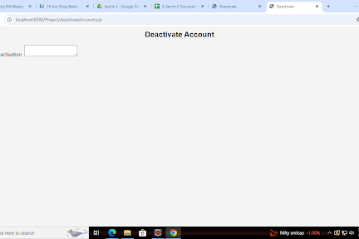
Account Deactivation:
accounts can be deactivated for users who have stopped using services.

Slide 13
Conclusion
Electricity Bill Management System is a project which simplifies the Important and complex task of paying electricity bills without ever visiting physical office.
New users can also register for the services via this project.

